Slide 1
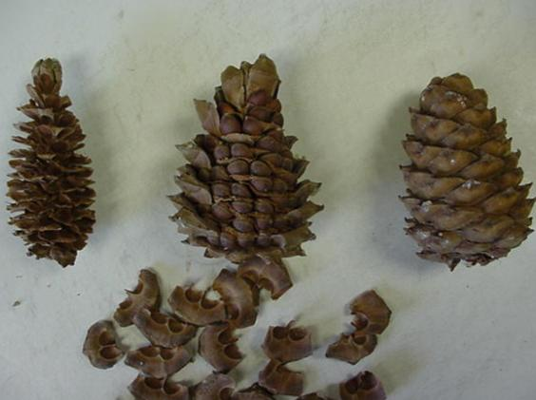
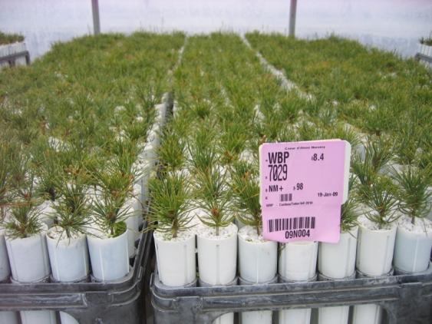
Recent Advances in Germination Technology: CDA Nursery Whitebark Pine Production

Slide 2
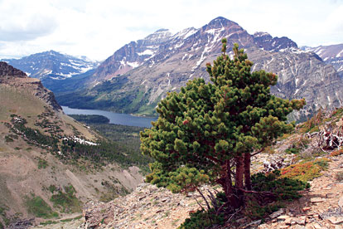
Whitebark Pine Summary:
Foundation high-elevation habitat species
Threatened by rust fungi (C. ribicola), uncharacteristically severe wildfire, and pine beetles
Restoration is complicated by slow growth, site severity, and limited access
Planting rust-resistant containerized seedlings is currently the standard (Mahalovich, et al 2006)

Slide 3
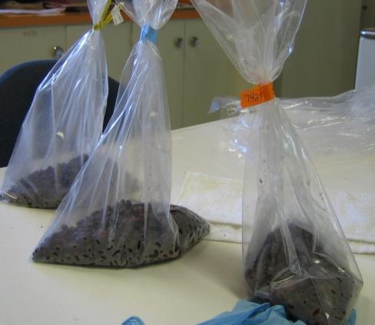
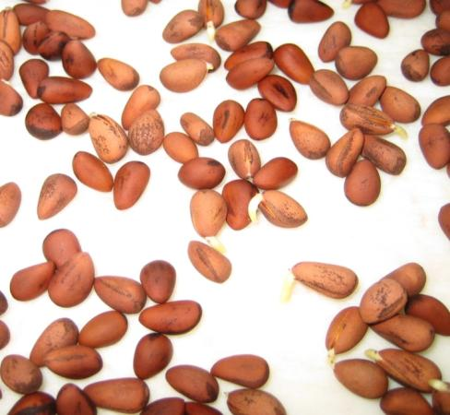
WBP Production at CdA Nursery
Began in 1985
Over 2,000 separate WBP seed lots
Over 3,055 lbs of WBP seed processed since 1985
Over 1,200 lbs of WBP seed currently stored

Slide 4
WBP Seed Processing Trend:

Slide 5
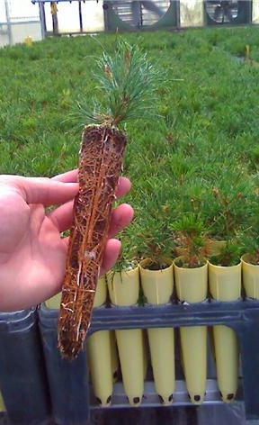
High-Five Pine Seedling Production
Container stock WBP
Produced for restoration since 1990’s
Many Forests in Regions 1, 2, 4, and 6
Over 624,000 trees produced since 1990
Continuing to streamline production

Slide 6
WBP Seedling Production Trend:
Sowing Year

Slide 7
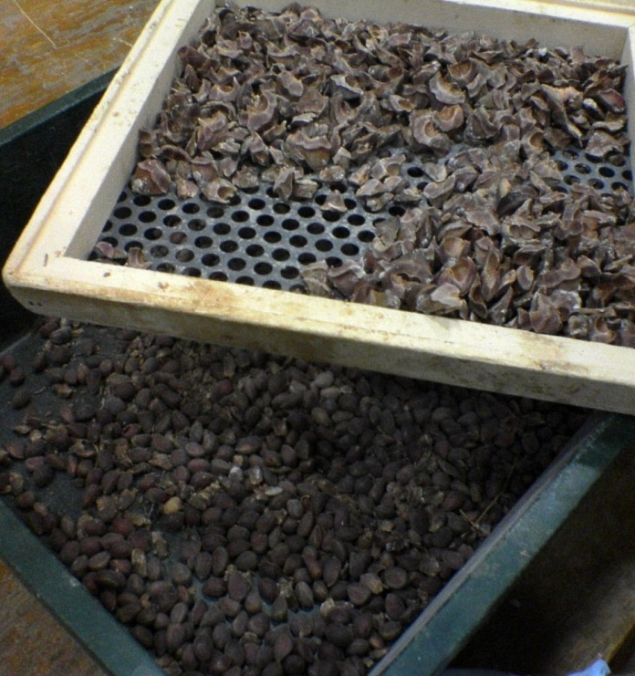
Obstacles to WBP Germination
Physiological embryo dormancy (requires stratification)
Seed coat dormancy / impermeability (requires scarification) (Riley, et al 2007)
Historically poor and inconsistent germination
Scant research on WBP germination protocols

Slide 8
Existing Protocols
Grower | Pre-Treatment | Warm Strat | Cold Strat | Scarification | Germination
Dorena Genetic Resource Center* | H2O2 Soak / Rinse | 30 days @ 50°F | 90 days @ 33-35°F | Seeds individually hand sanded along center-line. | Small seedlots; germinated artificially, then hand transplanted.
Glacier National Park** | 48 hr cold-water rinse (+ pre-strat scarif.) | 90 days @ 70°F day / 64°F night | 30-100 days @ 33-35°F | Pre-strat, seeds individually hand sanded or knicked. | Direct seeded into containers, or germinated artificially, and hand transplanted.
Coeur d’ Alene Nursery | 48 hr cold-water rinse | 30 days @ 50-60 °F | 60 days @ 33-35°F | 3-4 hours mechanized sanding of bulk seed | Direct seeded into containers, minimal/no hand transplanting
*Riley, et al 2007
**Wick, et al 2008

Slide 9
2010 WBP Crop
Scarification study conducted at CdA Nursery-
4 seedlots, 9 sanding treatments, 3.0 - 7.5 hours
Showed no significant difference between lots sanded 3+ hours

Slide 10
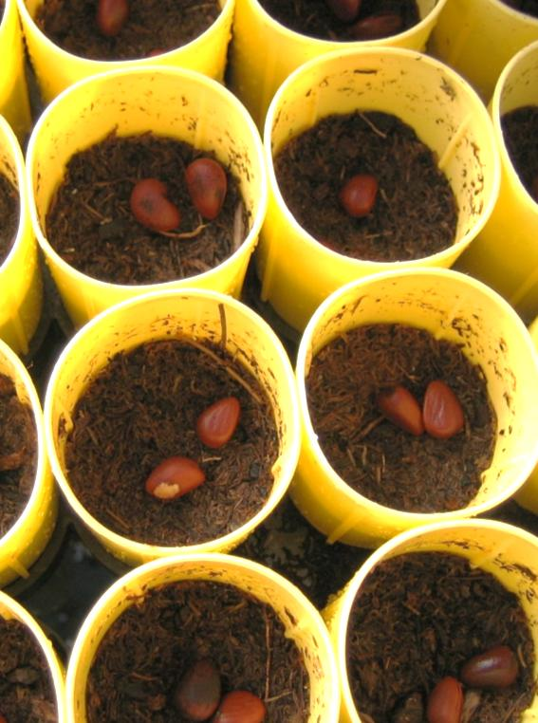
2011 WBP Crop
No study conducted
Erratic and lower than expected germination
Considerable latent germination, especially when exposed to direct sun / warm temperatures
New germinate crop after additional 30 day cold stratification

Slide 11
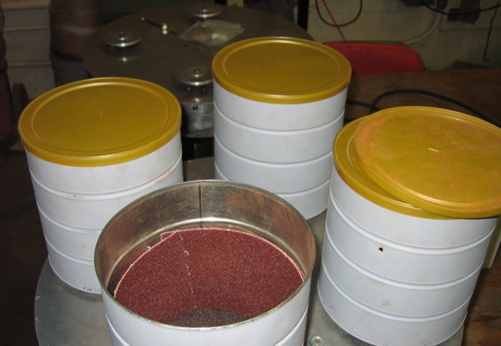
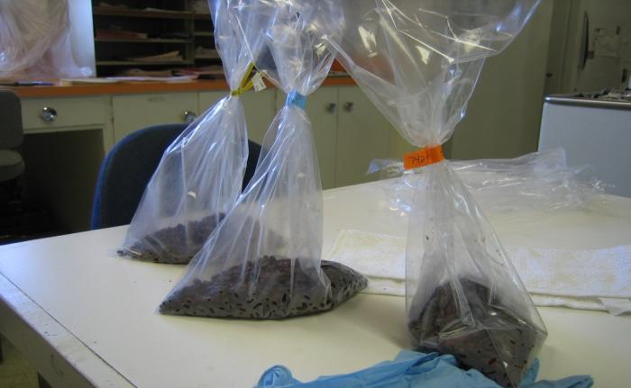
2012 WBP Crop
Goal: Increase operational production efficiency by:
Improving germination consistency
Eliminating the need for re-stratification
Reducing handling and sorting costs, and media waste
Using valuable seed more efficiently
Stratification study conducted at CdA Nursery
Current scarification protocols + increased stratification

Slide 12
Existing Protocols
Grower | Pre-Treatment | Warm Strat | Cold Strat | Scarification | Germination
Dorena Genetic Resource Center * | H2O2 Soak / Rinse | 30 days @ 50°F | 90 days @ 33-35°F | Seeds individually hand sanded along center-line. | Small seedlots; germinated artificially, then hand transplanted.
Glacier National Park ** | 48 hr cold-water rinse (+ pre-strat scarification) | 90 days @ 70°F day / 64°F night | 30-100 days @ 33-35°F | Pre-strat, seeds individually hand sanded or knicked. | Direct seeded into containers, or germinated artificially, and hand transplanted.
Coeur d’ Alene Nursery | 48 hr cold-water rinse | 30 days @ 50-60 °F | 60 days @ 33-35°F | 3 hours mechanized sanding of bulk seed | Direct seeded into containers, minimal/no hand transplanting
*Riley, et al 2007
**Wick, et al 2008

Slide 13
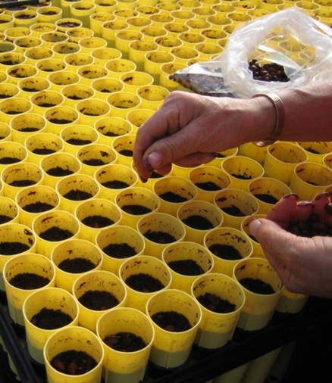
Materials and Methods
23 operational seedlots, 6 breeding zones
30 warm / 90 cold strat + 3 hour bulk sanding
Standard operational greenhouse growing conditions
Measured number of viable germinates in August, 2012. (at least 7% sample size per lot, average 23%)
Factors included:
Breeding zone
Sowing date
Source elevation
Seedlot age

Slide 14
Results - Overall Germination

Slide 15
Results – Germination by Factors
Breeding Zone
Sowing Date
R² < 0.001
Elevation (K ft.)
Seed Collection Date

Slide 16
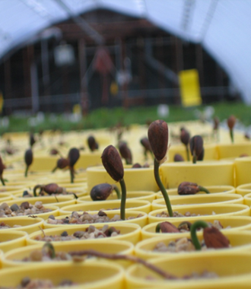
Discussion – 2012 Data
Consistent germination near 70%
No significant correlation between germination and:
Breeding zone
Sowing date
Source elevation
No significant correlation between germ and collection year, but data is limited

Slide 17
Discussion – 2011 vs. 2012 Germination

Slide 18
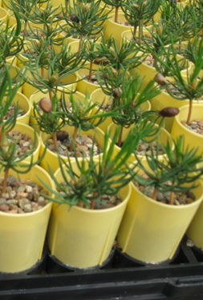
Conclusions
Using new WBP stratification / scarification protocol,
Seed origin, elevation, and sow date showed no significant effect on germination percentage
Seed age showed no significant effect on germination, although most lots (78%) were 2009 or newer
Compared to 2011, 2012 sowing had far superior initial germination, presumably due to increased stratification time

Slide 19
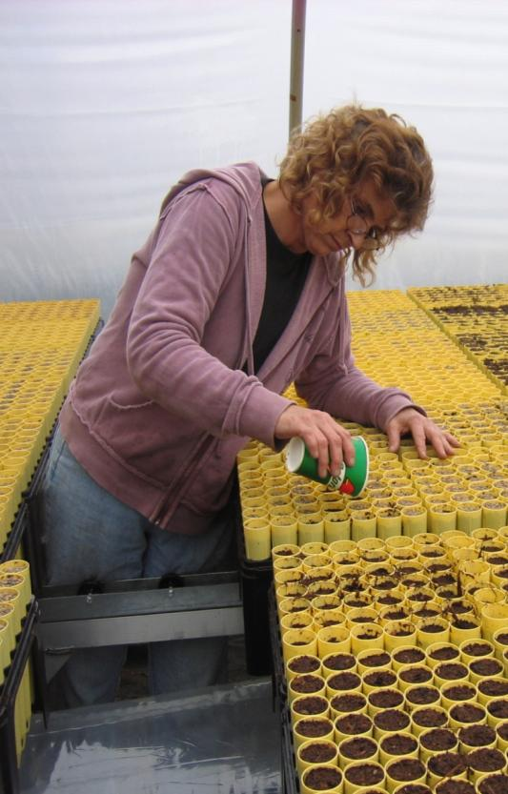
Direction for CdA Nursery
120 day strat, less emphasis on other factors
Reduce % oversow = seed savings
Request clients make timely orders (Sept.-Oct.)!
Test for seed age effect
Test sowing techniques, top dressing, etc. to increase lg. scale production efficiency

Slide 20
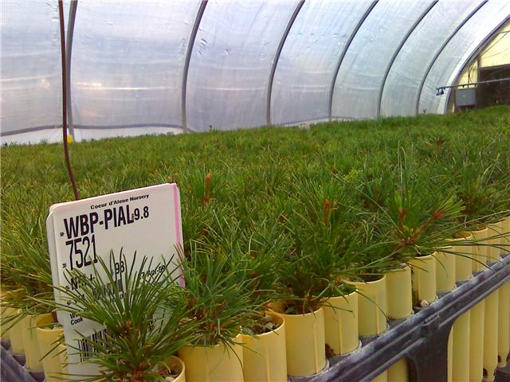
Questions, Comments, Concerns?

Slide 21
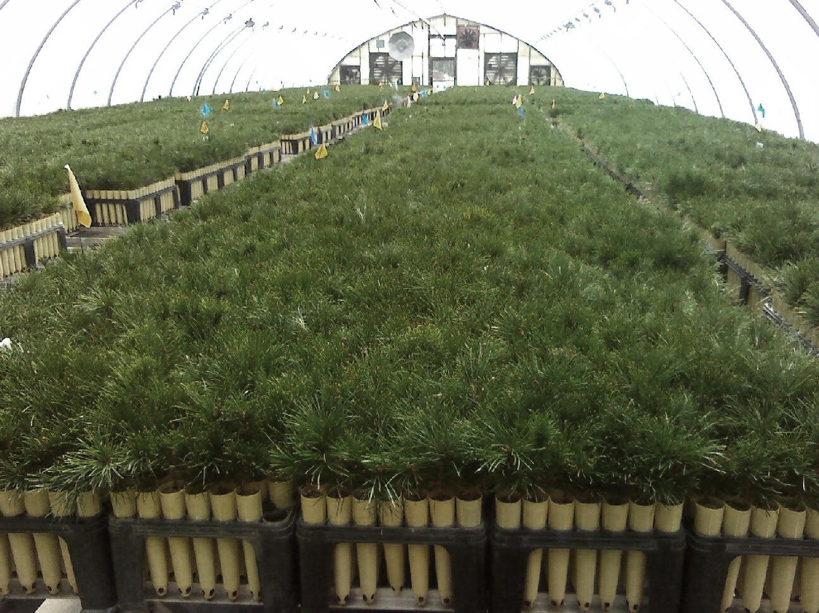
References
Mahalovich, MF, Burr, KE, and Foushee, DL. 2006. Whitebark pine germination, rust resistance, and cold hardiness among seed sources in the Inland Northwest: Planting strategies for restoration. In: USDA Forest Service Proceedings RMRS-P-43. 2006.
Riley, LE, Coumas, CM, Danielson, JF, and Berdeen, JC. 2007. Seedling nursery culture of whitebark pine at Dorena Genetic Resource Center: Headakes, successes, and growing pains. In: USDA Forest Service R6-NR-FHP-2007-01.
Wick, D, Luna, T, Evans, J, and Hosokowa, J. 2008. Propagation protocol for production of container Pinus albicaulis Engelm. Plants (172 ml conetainers); USDI NPS-Glacier National Park, West Glacier, MT. In: Native Plant Network.

